Slide 1
Electrical Circuits Lecture 2: Voltage/Current Laws By: Mahmoud Momtazpour ceit.aut.ac.ir/~momtazpour
Amirkabir University of Technology

Slide 2
Topic Overview
Voltage/Current Laws
Series/Parallel Circuits
Voltage/Current Division

Slide 3
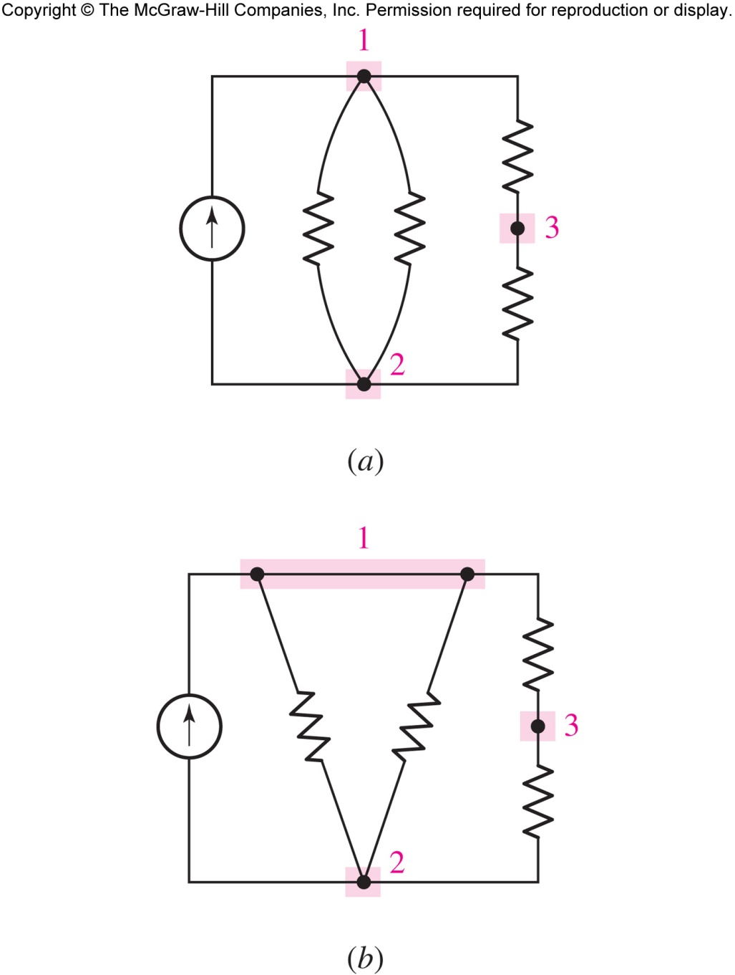
Nodes, Paths, Loops, Branches
these two networks are equivalent
there are three nodes and five branches
a path is a sequence of nodes
a loop is a closed (circular) path

Slide 4
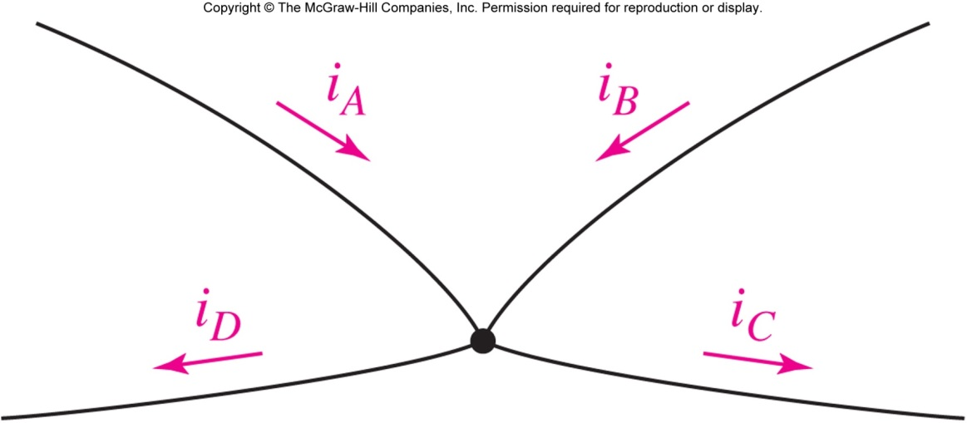
Kirchhoff’s Current Law
KCL: The algebraic sum of the currents entering any node is zero.
i_{A} + i_{B} + (−i_{C}) + (−i_{D}) = 0

Slide 5
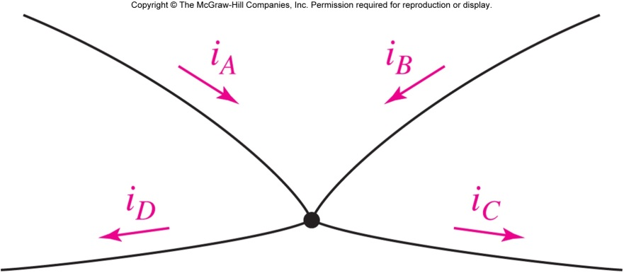
KCL: Alternative Forms
Current IN is zero:
i_{A} + i_{B} + (−i_{C}) + (−i_{D}) = 0
Current OUT is zero:
(-i_{A} )+ (-i_{B} ) + i_{C} + i_{D} = 0
Current IN=OUT:
i_{A}+ i_{B} = i_{C} + i_{D}

Slide 6
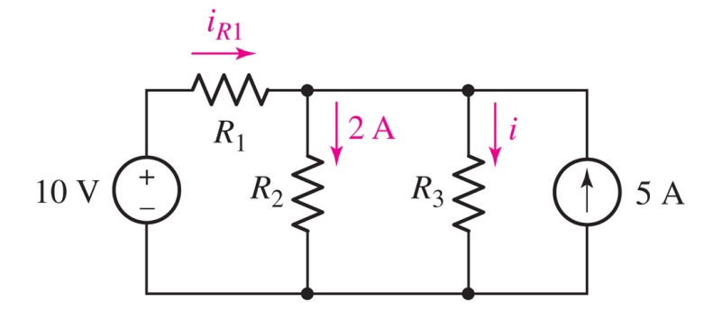
Example of KCL Application
Find the current through resistor R₃ if it is known that the voltage source supplies a current of 3 A.
Answer: i =6 A

Slide 7
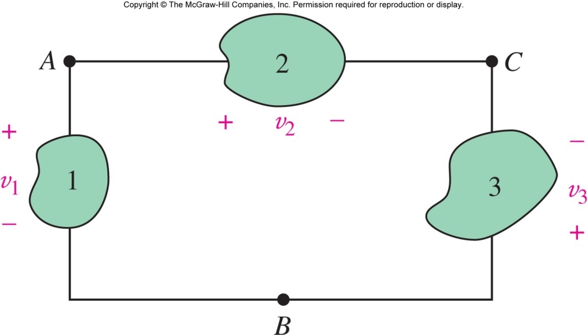
Kirchhoff’s Voltage Law
KVL: The algebraic sum of the voltages around any closed path is zero.
v₁ + (-v₂ )+ v₃= 0

Slide 8
KVL: Alternative Forms
Sum of RISES is zero (clockwise from B):
v₁ +(- v₂ ) + v₃ = 0
Sum of DROPS is zero (clockwise from B):
(-v₁ ) + v₂ + (-v₃ ) = 0
Two paths, same
voltage (A to B):
v₁ = (-v₃ ) + v₂

Slide 9
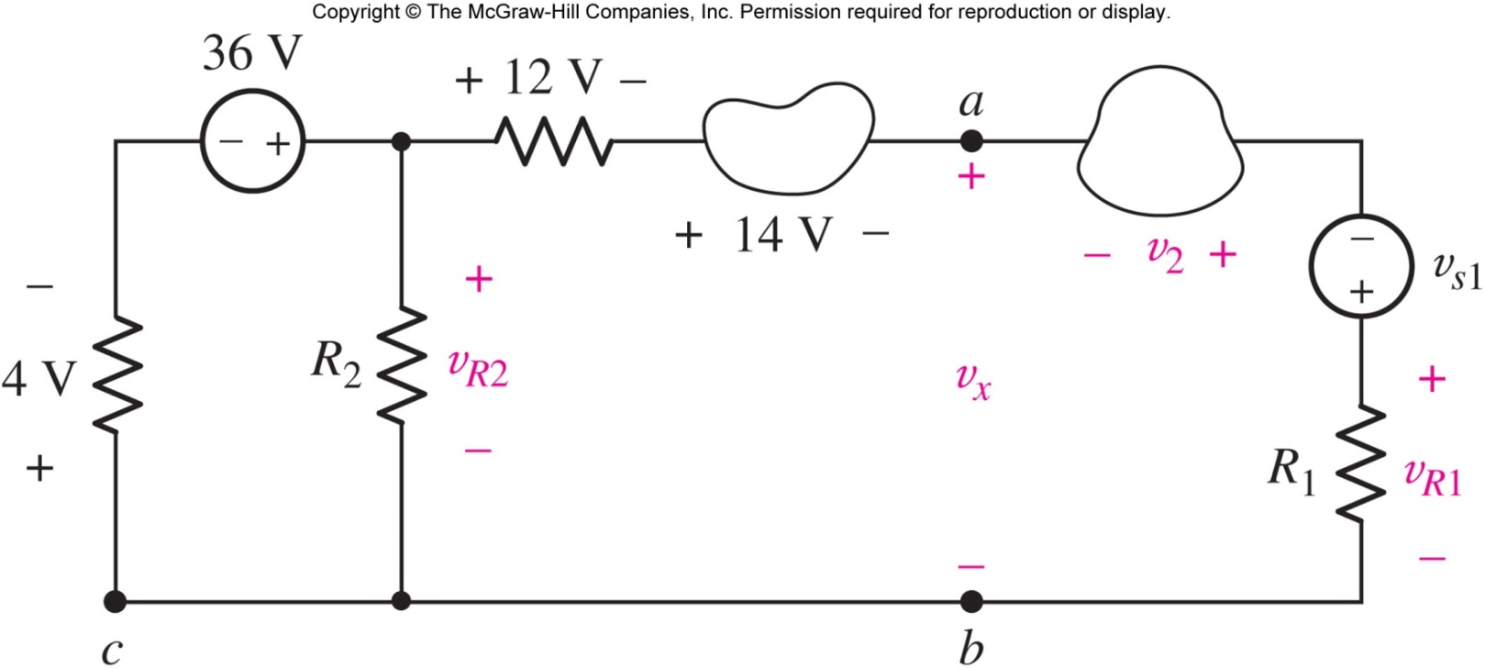
Example: Applying KVL
Find v_{R2} (the voltage across R₂) and the voltage v_{x}.
Answer: v_{R2} = 32 V and v_{x}= 6 V.

Slide 10
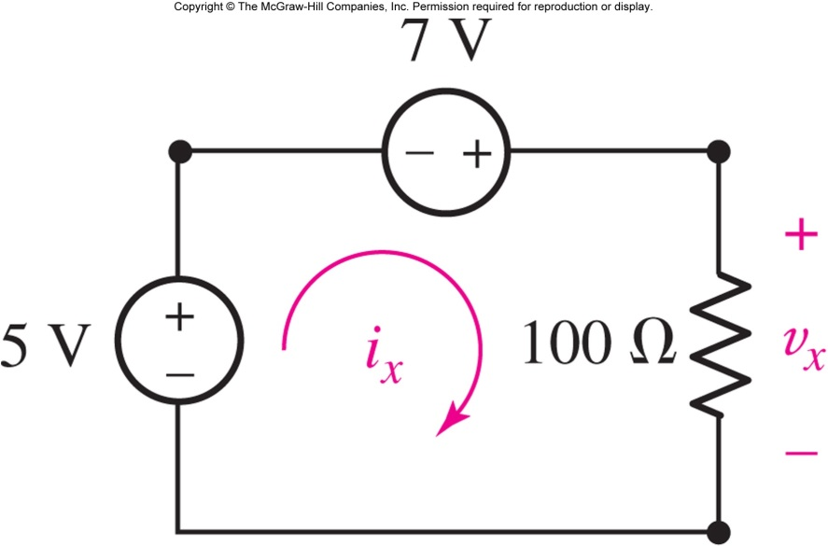
Applying KVL, KCL, Ohm’s
Example: find the current i_{x} and the voltage v_{x}
Answer: v_{x}= 12 V and i_{x} =120 mA

Slide 11
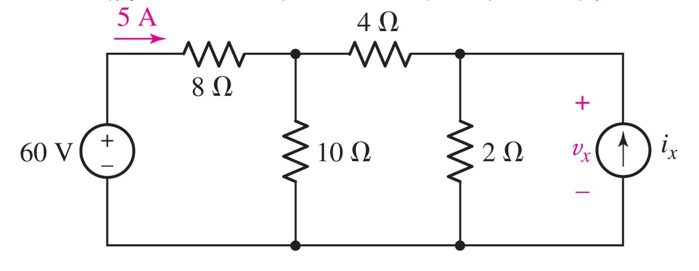
Applying KVL, KCL, Ohm’s
Solve for the voltage v_{x} and and the current i_{x}
Answer: v_{x}=8 V and i_{x}= 1 A

Slide 12
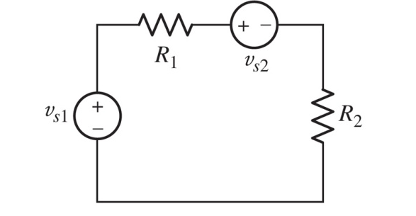
Series Connections
All of the elements in a circuit that carry the same current are said to be connected in series.

Slide 13
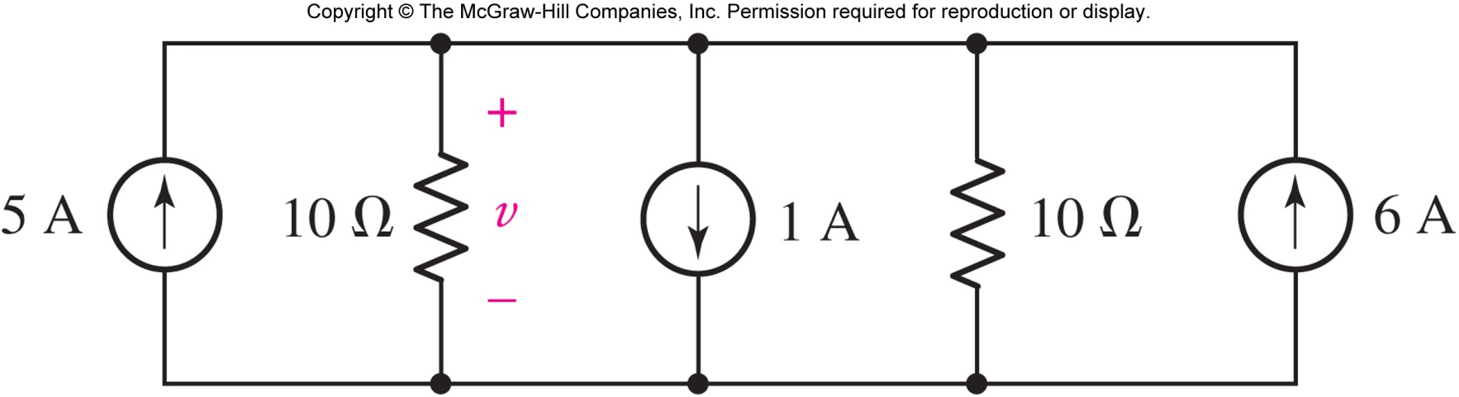
Parallel Connections
Elements in a circuit having a common voltage across them are said to be connected in parallel.
13

Slide 14
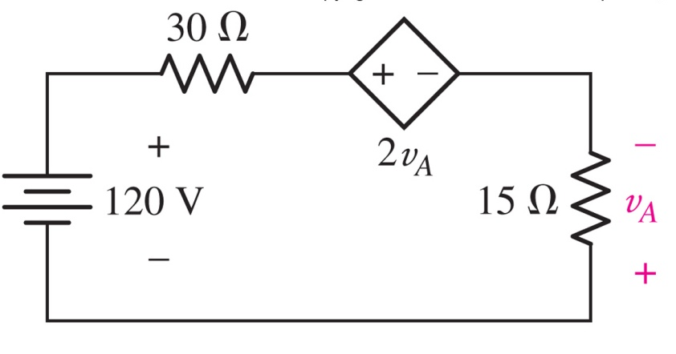
Example: Single Loop Circuit
Calculate the power absorbed by each circuit element.
Answer:
p_{120V} = −960 W, p₃₀ = 1920 W
p_{dep} = −1920 W, p₁₅ = 960 W

Slide 15
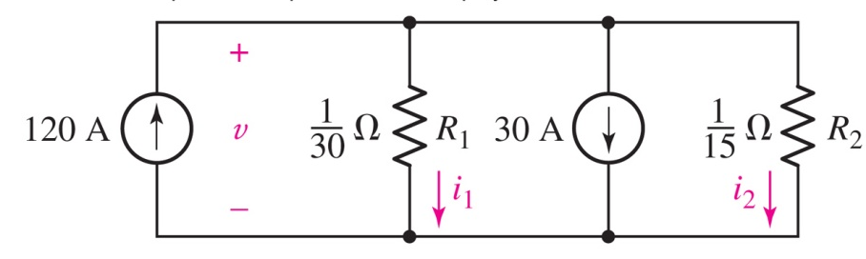
Example: Single Node-Pair Circuit
Find the voltage v and the currents i₁ and i₂.
Answer: v = 2 V, i₁ = 60 A, and i₂ = 30 A

Slide 16
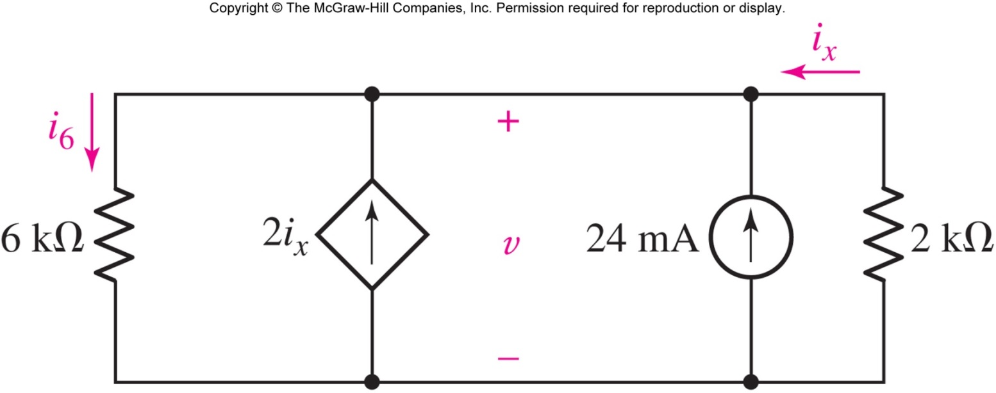
Example: Single Node-Pair Circuit
Determine the value of v and the power supplied by the independent current source.
Answer: v = 14.4 V, power from current source is 345.6 mW

Slide 17
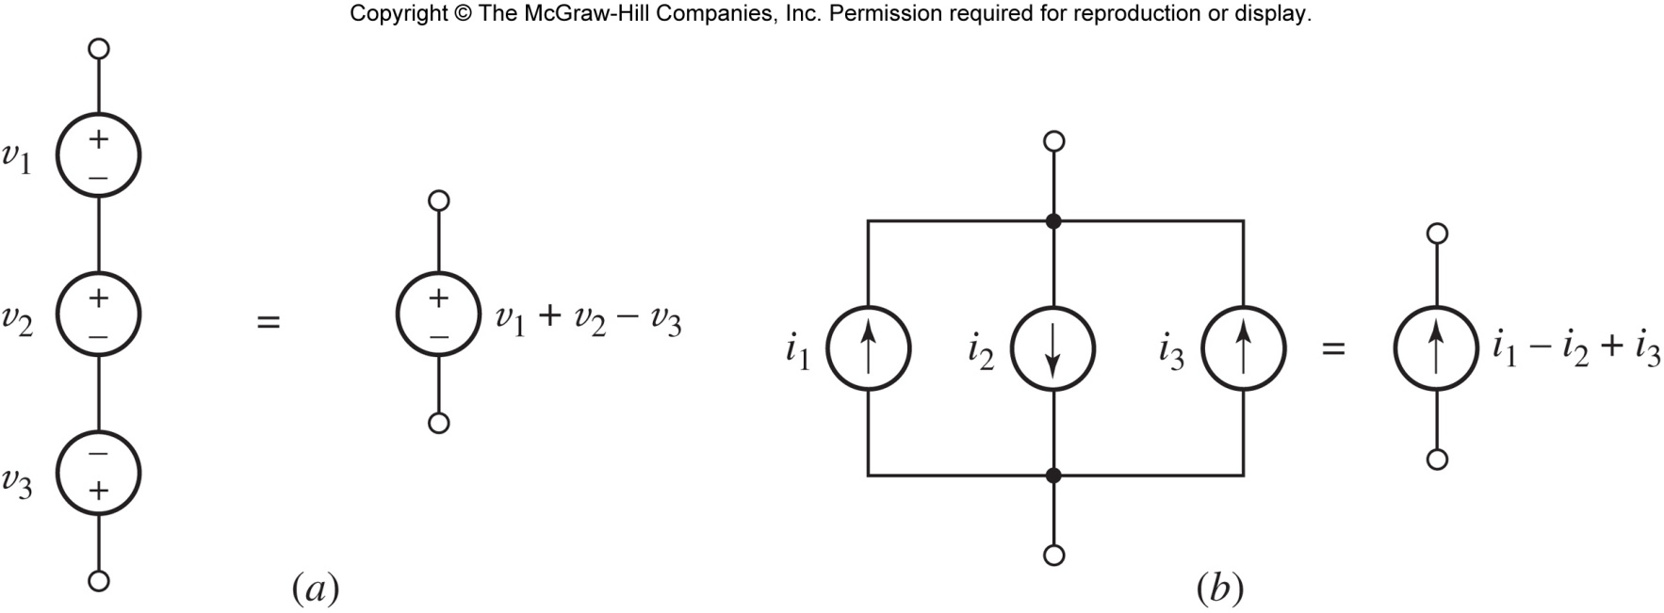
Series and Parallel Sources
Voltage sources connected in series can be combined into an equivalent voltage source:

Slide 18
Series and Parallel Sources
Current sources connected in parallel can be combined into an equivalent current source:

Slide 19
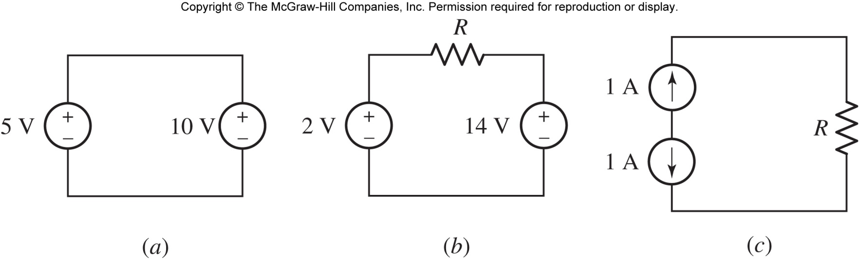
Impossible Circuits
Our circuit models are idealizations that can lead to apparent physical absurdities:
V_{s} in parallel (a) and I_{s} in series (c) can lead to “impossible circuits”

Slide 20
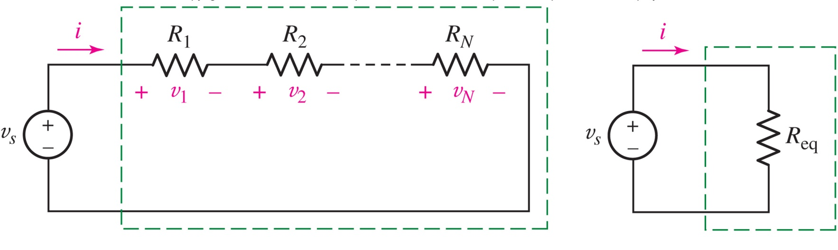
Resistors in Series
Using KVL shows:
R_{eq} = R₁ + R₂ + … + R_{N}

Slide 21
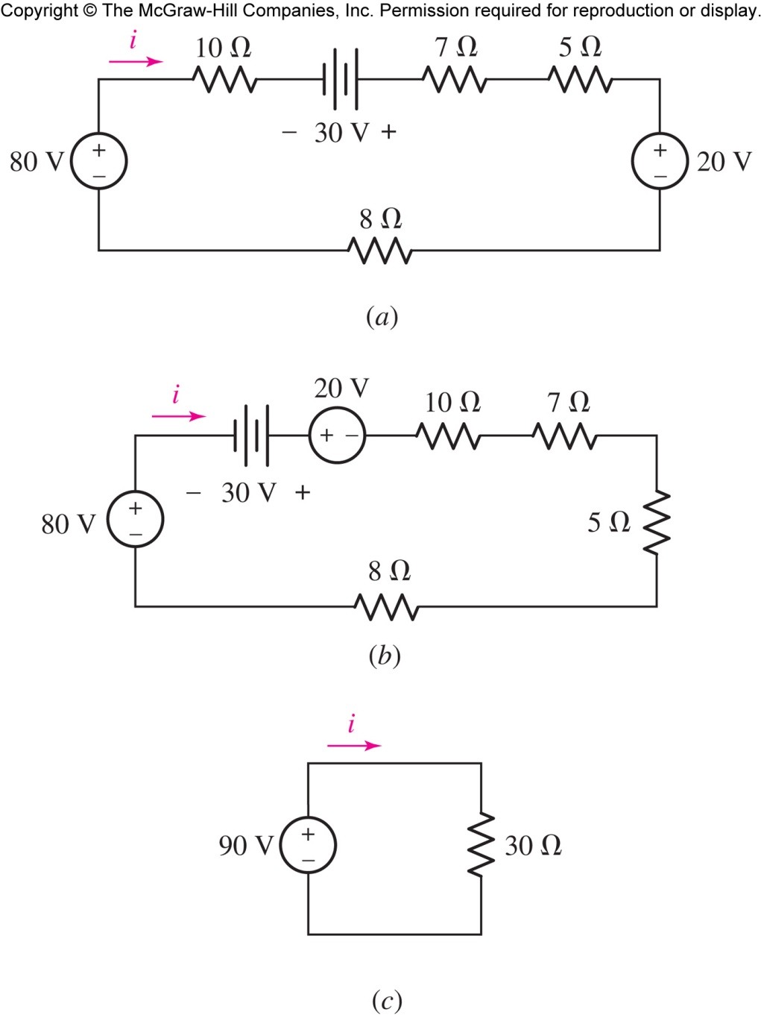
Example: Circuit Simplifying
Find i and the power supplied by the 80 V source.
Answer: i = 3 A and p = 240 W supplied

Slide 22
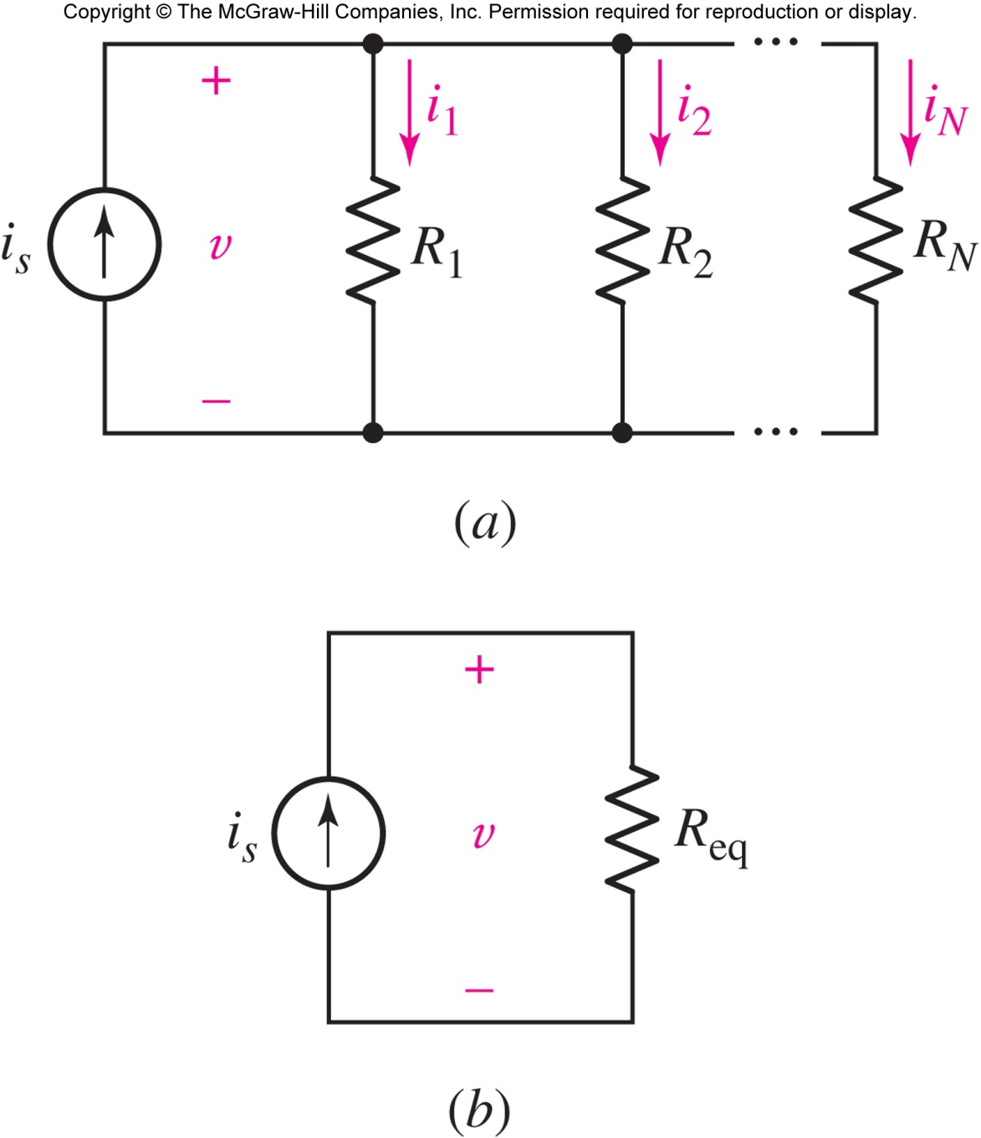
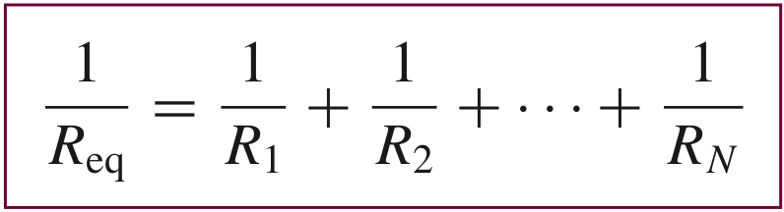
Resistors in Parallel
Using KCL shows:

Slide 23
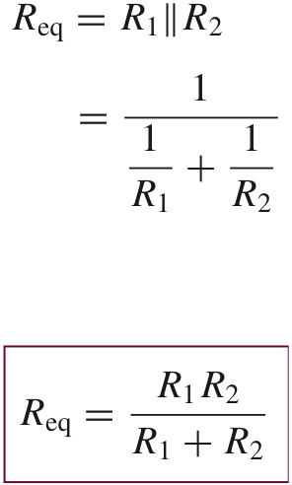
Two Resistors in Parallel
Two resistors in parallel can be combined using the
product / sum
shortcut.
Connecting resistors in parallel makes the result smaller :
0.5 min(R_{1,} R₂) < R₁||R₂ < min(R₁,R₂)

Slide 24
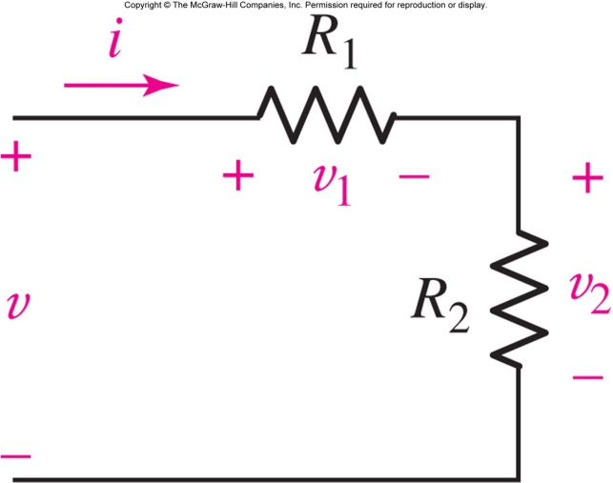
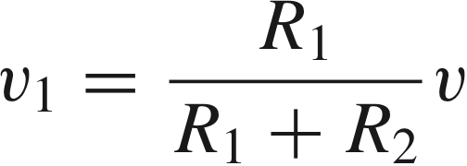
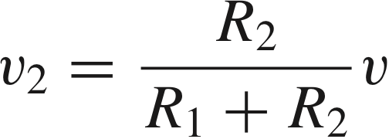
Voltage Division
Resistors in series “share” the voltage applied to them.

Slide 25
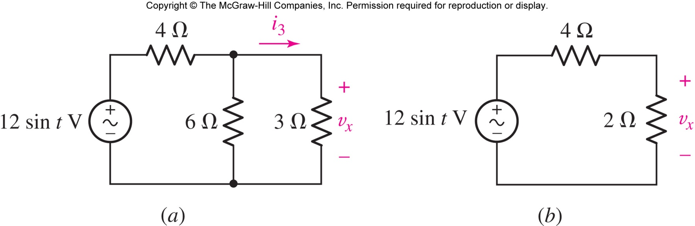
Example: Voltage Division
Find v_{x}
Answer: v_{x}(t) = 4 sin t V

Slide 26
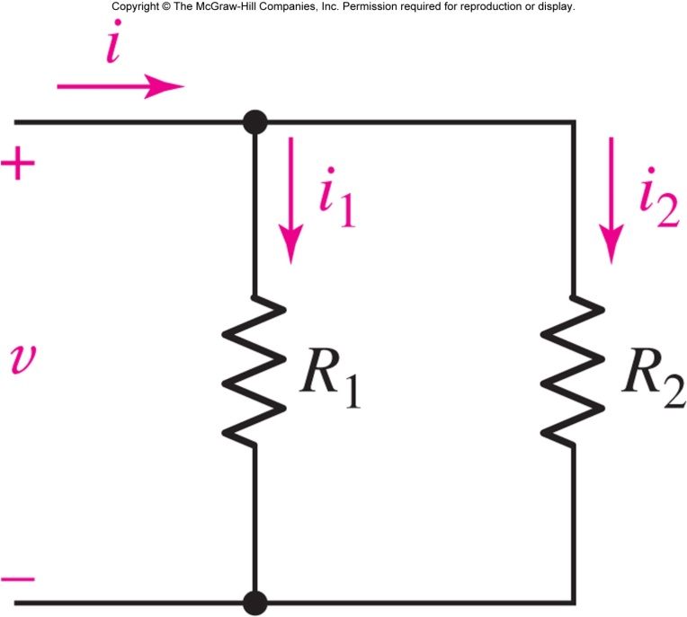
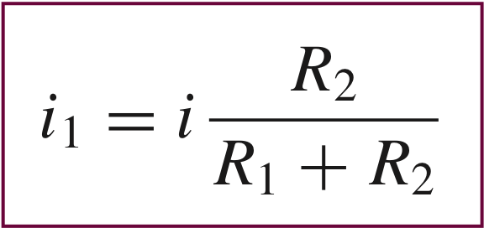
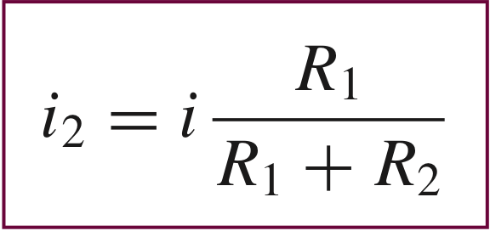
Current Division
Resistors in parallel “share” the current through them.

Slide 27
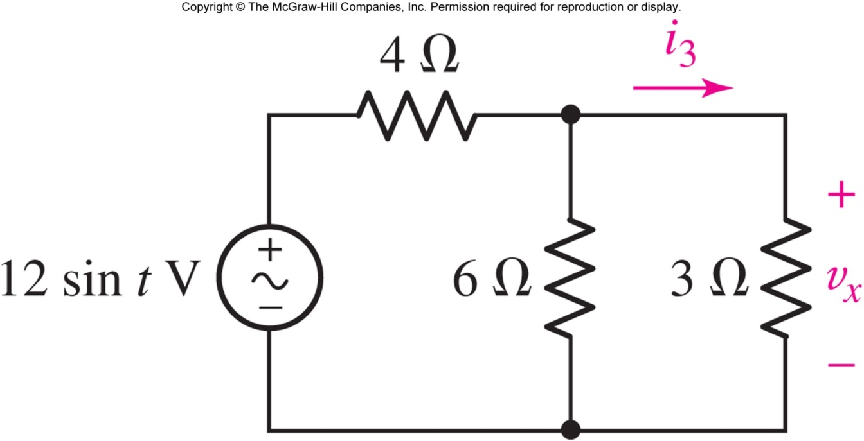
Example: Current Division
Find i₃(t)
Answer: i₃(t) = 1.333 sin t V

Slide 28
Summary
Can you explain how we use these to analyze the circuits?
KVL, KCL?
Series/Parallel Resistors, or Sources?
Voltage/Current Division?

Slide 29
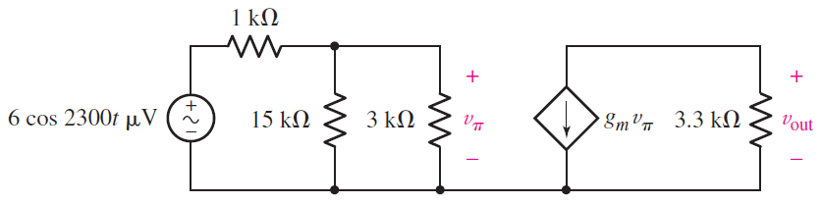
In-class Exercise
Find V_{out} if g_{m}=322mS

